Slide 1
业余射电天文——21cm八木设计3
QQ交流群：926020514
论坛：http://radioastronomy.online/

Slide 2
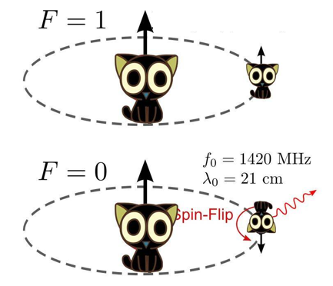
目录
21cm八木设计3
八木天线及其增益/长度的估算
设计18dBi增益的八木天线
补充：前后比、最大旁瓣水平、回波损耗
优化方法1——所有变量一起优化
优化方法2——分步优化

Slide 3
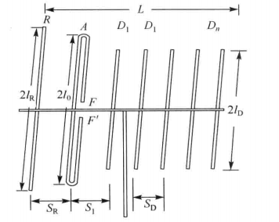
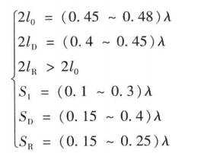
八木天线及其增益/长度的估算
$$G≈10∗\log_{10}(10∗\frac{L}{λ})$$
$$\frac{L}{λ}≈\frac{{10}^{(G/10)}}{10}$$

Slide 4
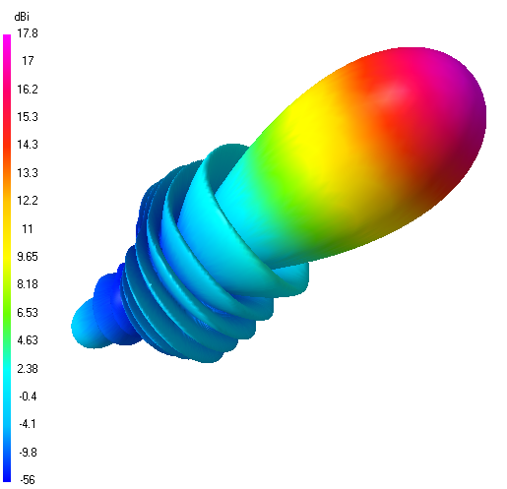
八木天线估算增益和仿真增益对比
1.45m
仿真结果
八木尺寸
公式估算
$$G≈10∗\log_{10}(10∗\frac{L}{λ})=10∗\log_{10}(10∗\frac{145cm}{21cm})=18.40dBi$$

Slide 5
设计18dBi增益的八木天线
要求18dBi增益，为了保险，设计目标定为18.5dBi
然后估算需要多长的八木天线
长度估算
$$\frac{L}{λ}≈\frac{{10}^{(G/10)}}{10}=\frac{{10}^{(18.5/10)}}{10}≈7.08$$
任意选取初始尺寸
$$\left\{\begin{aligned}激励单元长度=0.47λ \\ 引向单元长度=(0.4\sim 0.45)λ \\ 反射单元长度=0.5λ \\ 激励单元到第一根引向单元间距=0.25λ \\ 剩余引向单元之间的间距=0.25λ(前2根)，0.35λ（后面的） \\ 反射单元到激励单元间距=0.2λ\end{aligned}\right.$$

Slide 6
由间距计算需要多少根单元
$$\frac{L}{λ}≈\frac{{10}^{(G/10)}}{10}=\frac{{10}^{(18.5/10)}}{10}≈7$$
$$\left\{\begin{aligned}激励单元长度=0.47λ \\ 引向单元长度=(0.4\sim 0.45)λ \\ 反射单元长度=0.5λ \\ 激励单元到第一根引向单元间距=0.25λ \\ 剩余引向单元之间的间距=0.25λ(前2根)，0.35λ（后面的） \\ 反射单元到激励单元间距=0.2λ\end{aligned}\right.$$
$$7−0.25∗2−0.25−0.2=6.05$$
$$6.05÷0.35≈17$$
总共需要22根单元
1根反射单元
1根激励单元
1+2+17=20根引向单元

Slide 7
计算引向单元的长度
$$\begin{aligned}激励单元长度=0.47λ \\ 引向单元长度=(0.4\sim 0.45)λ \\ 反射单元长度=0.5λ \\ 激励单元到第一根引向单元间距=0.25λ \\ 剩余引向单元之间的间距=0.25λ(前2根)，0.35λ（后面的） \\ 反射单元到激励单元间距=0.2λ\end{aligned}$$
已计算出需要20根引向单元
长度由$0.45λ$均匀递减至$0.4λ$，计算每次递减的量
$$(0.45λ−0.4λ)/(20−1)≈0.00263λ$$

Slide 8
列出尺寸表
单元 | 位置（$λ$） | 长度（$λ$） | 单元 | 位置（𝝀） | 长度（𝝀）
R1 | 0 | 0.5 | D10 | 3.40 | 0.42633
Drv. | 0.2 | 0.47 | D11 | 3.75 | 0.42370
D1 | 0.45 | 0.45 | D12 | 4.10 | 0.42107
D2 | 0.70 | 0.44737 | D13 | 4.45 | 0.41844
D3 | 0.95 | 0.44474 | D14 | 4.80 | 0.41581
D4 | 1.3 | 0.44211 | D15 | 5.15 | 0.41318
D5 | 1.65 | 0.43948 | D16 | 5.50 | 0.41055
D6 | 2.0 | 0.43685 | D17 | 5.85 | 0.40792
D7 | 2.35 | 0.43422 | D18 | 6.20 | 0.40529
D8 | 2.70 | 0.43159 | D19 | 6.55 | 0.40266
D9 | 3.05 | 0.42896 | D20 | 6.90 | 0.40003

Slide 9
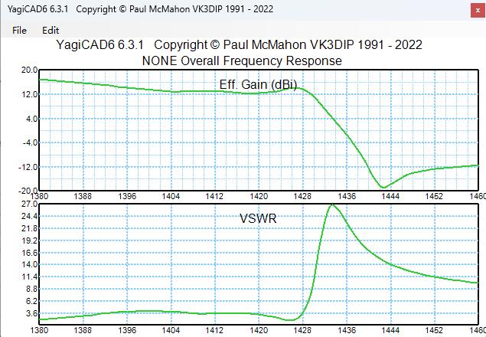
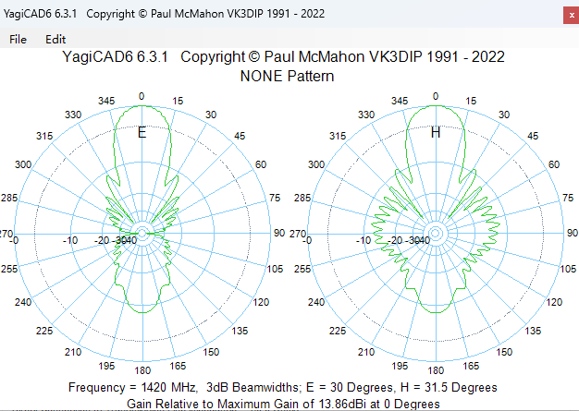
仿真结果

Slide 10
补充：前后比、最大旁瓣水平、回波损耗
P1
回波损耗（Return loss）：就是反射系数的相反数
假如天线在1420MHz的反射系数为-23dB，那么回波损耗就是23dB。
两个名字是一个意思，见到回波损耗直接加上负号转为反射系数。
P3
P2
前后比（F/B）：P1-P2
最大旁瓣水平（MaxSL）：P3-P1

Slide 11
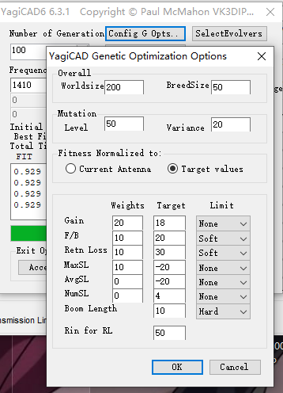
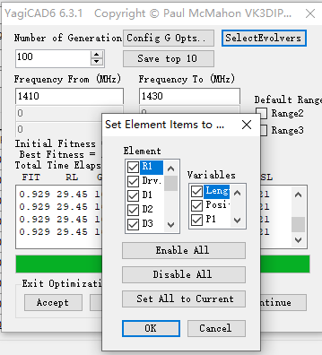
优化方法1——所有变量一起优化
单元
勾选
变量
权重
目标值
长度
位置
增益
前后比
回波损耗
最大旁瓣水平
选择要优化的变量
设置优化目标

Slide 12
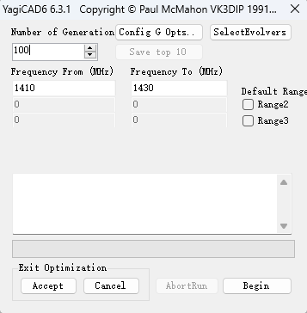
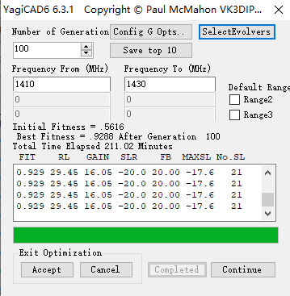
优化方法1——所有变量一起优化
0.562 4.10 14.86 -15.5 10.84 -9.6 27
0.562 4.10 14.86 -15.5 10.84 -9.6 27
0.562 4.10 14.86 -15.5 10.84 -9.6 27
0.577 8.16 12.02 -11.0 19.29 -6.3 21
0.587 23.48 9.41 -7.8 19.18 -3.0 23
0.604 8.29 13.59 -12.0 17.47 -7.2 16
0.634 23.62 10.60 -7.7 18.88 -5.2 19
0.705 21.92 13.56 -11.9 17.02 -8.7 18
0.711 9.30 15.55 -14.9 20.00 -10.4 20
0.736 13.75 14.65 -15.0 19.70 -12.2 21
0.753 27.91 13.69 -13.6 18.96 -7.3 19
0.753 27.91 13.69 -13.6 18.96 -7.3 19
0.760 21.84 14.41 -13.4 20.00 -9.4 14
0.823 30.00 15.26 -18.3 19.34 -9.0 18
0.823 30.00 15.26 -18.3 19.34 -9.0 18
0.823 30.00 15.26 -18.3 19.34 -9.0 18
0.823 30.00 15.26 -18.3 19.34 -9.0 18
0.848 28.27 15.29 -15.6 19.55 -12.5 19
0.848 28.27 15.29 -15.6 19.55 -12.5 19
0.848 28.27 15.29 -15.6 19.55 -12.5 19
0.848 28.27 15.29 -15.6 19.55 -12.5 19
0.848 28.27 15.29 -15.6 19.55 -12.5 19
0.848 28.27 15.29 -15.6 19.55 -12.5 19
0.848 28.27 15.29 -15.6 19.55 -12.5 19
0.848 28.27 15.29 -15.6 19.55 -12.5 19
0.848 28.27 15.29 -15.6 19.55 -12.5 19
0.848 28.27 15.29 -15.6 19.55 -12.5 19
0.861 24.65 16.50 -18.7 20.00 -13.0 19
0.861 24.65 16.50 -18.7 20.00 -13.0 19
0.865 24.68 16.36 -16.8 19.76 -14.0 23
0.865 24.68 16.36 -16.8 19.76 -14.0 23
0.865 24.68 16.36 -16.8 19.76 -14.0 23
0.865 24.68 16.36 -16.8 19.76 -14.0 23
0.865 24.68 16.36 -16.8 19.76 -14.0 23
0.892 27.60 16.48 -18.3 20.00 -14.2 19
0.892 27.60 16.48 -18.3 20.00 -14.2 19
0.892 27.60 16.48 -18.3 20.00 -14.2 19
0.892 27.60 16.48 -18.3 20.00 -14.2 19
0.892 27.60 16.48 -18.3 20.00 -14.2 19
0.892 27.60 16.48 -18.3 20.00 -14.2 19
0.898 29.06 16.54 -17.9 19.39 -14.3 22
0.898 29.06 16.54 -17.9 19.39 -14.3 22
0.898 29.06 16.54 -17.9 19.39 -14.3 22
0.898 29.06 16.54 -17.9 19.39 -14.3 22
0.898 29.06 16.54 -17.9 19.39 -14.3 22
0.898 29.06 16.54 -17.9 19.39 -14.3 22
0.898 29.06 16.54 -17.9 19.39 -14.3 22
0.898 29.06 16.54 -17.9 19.39 -14.3 22
0.898 29.06 16.54 -17.9 19.39 -14.3 22
0.898 29.06 16.54 -17.9 19.39 -14.3 22
0.898 29.06 16.54 -17.9 19.39 -14.3 22
0.898 29.06 16.54 -17.9 19.39 -14.3 22
0.898 29.06 16.54 -17.9 19.39 -14.3 22
0.905 30.00 16.31 -16.7 19.98 -14.3 20
0.905 30.00 16.31 -16.7 19.98 -14.3 20
0.905 30.00 16.31 -16.7 19.98 -14.3 20
0.905 30.00 16.31 -16.7 19.98 -14.3 20
0.905 30.00 16.31 -16.7 19.98 -14.3 20
0.905 28.05 15.88 -19.9 20.00 -16.5 21
0.906 28.23 16.22 -19.6 20.00 -15.8 19
0.907 28.62 15.98 -20.6 20.00 -16.1 23
0.907 28.62 15.98 -20.6 20.00 -16.1 23
0.907 28.70 15.70 -19.7 20.00 -16.7 20
0.910 29.05 15.96 -19.5 20.00 -16.2 19
0.910 29.05 15.96 -19.5 20.00 -16.2 19
0.910 29.05 15.96 -19.5 20.00 -16.2 19
0.915 28.54 15.93 -19.7 20.00 -17.0 20
0.919 27.82 16.11 -20.1 20.00 -17.6 21
0.919 27.82 16.11 -20.1 20.00 -17.6 21
0.919 27.82 16.11 -20.1 20.00 -17.6 21
0.919 27.82 16.11 -20.1 20.00 -17.6 21
0.919 27.82 16.11 -20.1 20.00 -17.6 21
0.919 27.82 16.11 -20.1 20.00 -17.6 21
0.920 28.12 16.18 -20.0 20.00 -17.3 20
0.920 28.12 16.18 -20.0 20.00 -17.3 20
0.921 28.54 16.10 -19.9 20.00 -17.3 21
0.926 27.89 16.25 -20.1 20.00 -17.9 21
0.926 27.89 16.25 -20.1 20.00 -17.9 21
0.926 27.89 16.25 -20.1 20.00 -17.9 21
0.926 27.89 16.25 -20.1 20.00 -17.9 21
0.926 27.89 16.25 -20.1 20.00 -17.9 21
0.926 27.89 16.25 -20.1 20.00 -17.9 21
0.926 27.89 16.25 -20.1 20.00 -17.9 21
0.926 27.89 16.25 -20.1 20.00 -17.9 21
0.926 27.89 16.25 -20.1 20.00 -17.9 21
0.926 27.89 16.25 -20.1 20.00 -17.9 21
0.928 29.22 16.08 -19.9 20.00 -17.6 20
0.928 29.22 16.08 -19.9 20.00 -17.6 20
0.928 29.22 16.08 -19.9 20.00 -17.6 20
0.928 29.22 16.08 -19.9 20.00 -17.6 20
0.928 29.22 16.08 -19.9 20.00 -17.6 20
0.928 29.22 16.08 -19.9 20.00 -17.6 20
0.928 29.22 16.08 -19.9 20.00 -17.6 20
0.928 29.22 16.08 -19.9 20.00 -17.6 20
0.929 29.45 16.05 -20.0 20.00 -17.6 21
0.929 29.45 16.05 -20.0 20.00 -17.6 21
0.929 29.45 16.05 -20.0 20.00 -17.6 21
0.929 29.45 16.05 -20.0 20.00 -17.6 21
0.929 29.45 16.05 -20.0 20.00 -17.6 21
0.929 29.45 16.05 -20.0 20.00 -17.6 21
0.929 29.45 16.05 -20.0 20.00 -17.6 21
相似度 回波损耗 增益
前后比 最大旁瓣水平
迭代次数
频率范围
每次迭代的结果
中途停止
开始优化
接受结果
不接受
继续优化
开始优化
接受/不接受/继续优化

Slide 13
优化方法1——所有变量一起优化
0.562 4.10 14.86 -15.5 10.84 -9.6 27
0.562 4.10 14.86 -15.5 10.84 -9.6 27
0.562 4.10 14.86 -15.5 10.84 -9.6 27
0.577 8.16 12.02 -11.0 19.29 -6.3 21
0.587 23.48 9.41 -7.8 19.18 -3.0 23
0.604 8.29 13.59 -12.0 17.47 -7.2 16
0.634 23.62 10.60 -7.7 18.88 -5.2 19
0.705 21.92 13.56 -11.9 17.02 -8.7 18
0.711 9.30 15.55 -14.9 20.00 -10.4 20
0.736 13.75 14.65 -15.0 19.70 -12.2 21
0.753 27.91 13.69 -13.6 18.96 -7.3 19
0.753 27.91 13.69 -13.6 18.96 -7.3 19
0.760 21.84 14.41 -13.4 20.00 -9.4 14
0.823 30.00 15.26 -18.3 19.34 -9.0 18
0.823 30.00 15.26 -18.3 19.34 -9.0 18
0.823 30.00 15.26 -18.3 19.34 -9.0 18
0.823 30.00 15.26 -18.3 19.34 -9.0 18
0.848 28.27 15.29 -15.6 19.55 -12.5 19
0.848 28.27 15.29 -15.6 19.55 -12.5 19
0.848 28.27 15.29 -15.6 19.55 -12.5 19
0.848 28.27 15.29 -15.6 19.55 -12.5 19
0.848 28.27 15.29 -15.6 19.55 -12.5 19
0.848 28.27 15.29 -15.6 19.55 -12.5 19
0.848 28.27 15.29 -15.6 19.55 -12.5 19
0.848 28.27 15.29 -15.6 19.55 -12.5 19
0.848 28.27 15.29 -15.6 19.55 -12.5 19
0.848 28.27 15.29 -15.6 19.55 -12.5 19
0.861 24.65 16.50 -18.7 20.00 -13.0 19
0.861 24.65 16.50 -18.7 20.00 -13.0 19
0.865 24.68 16.36 -16.8 19.76 -14.0 23
0.865 24.68 16.36 -16.8 19.76 -14.0 23
0.865 24.68 16.36 -16.8 19.76 -14.0 23
0.865 24.68 16.36 -16.8 19.76 -14.0 23
0.865 24.68 16.36 -16.8 19.76 -14.0 23
0.892 27.60 16.48 -18.3 20.00 -14.2 19
0.892 27.60 16.48 -18.3 20.00 -14.2 19
0.892 27.60 16.48 -18.3 20.00 -14.2 19
0.892 27.60 16.48 -18.3 20.00 -14.2 19
0.892 27.60 16.48 -18.3 20.00 -14.2 19
0.892 27.60 16.48 -18.3 20.00 -14.2 19
0.898 29.06 16.54 -17.9 19.39 -14.3 22
0.898 29.06 16.54 -17.9 19.39 -14.3 22
0.898 29.06 16.54 -17.9 19.39 -14.3 22
0.898 29.06 16.54 -17.9 19.39 -14.3 22
0.898 29.06 16.54 -17.9 19.39 -14.3 22
0.898 29.06 16.54 -17.9 19.39 -14.3 22
0.898 29.06 16.54 -17.9 19.39 -14.3 22
0.898 29.06 16.54 -17.9 19.39 -14.3 22
0.898 29.06 16.54 -17.9 19.39 -14.3 22
0.898 29.06 16.54 -17.9 19.39 -14.3 22
0.898 29.06 16.54 -17.9 19.39 -14.3 22
0.898 29.06 16.54 -17.9 19.39 -14.3 22
0.898 29.06 16.54 -17.9 19.39 -14.3 22
0.905 30.00 16.31 -16.7 19.98 -14.3 20
0.905 30.00 16.31 -16.7 19.98 -14.3 20
0.905 30.00 16.31 -16.7 19.98 -14.3 20
0.905 30.00 16.31 -16.7 19.98 -14.3 20
0.905 30.00 16.31 -16.7 19.98 -14.3 20
0.905 28.05 15.88 -19.9 20.00 -16.5 21
0.906 28.23 16.22 -19.6 20.00 -15.8 19
0.907 28.62 15.98 -20.6 20.00 -16.1 23
0.907 28.62 15.98 -20.6 20.00 -16.1 23
0.907 28.70 15.70 -19.7 20.00 -16.7 20
0.910 29.05 15.96 -19.5 20.00 -16.2 19
0.910 29.05 15.96 -19.5 20.00 -16.2 19
0.910 29.05 15.96 -19.5 20.00 -16.2 19
0.915 28.54 15.93 -19.7 20.00 -17.0 20
0.919 27.82 16.11 -20.1 20.00 -17.6 21
0.919 27.82 16.11 -20.1 20.00 -17.6 21
0.919 27.82 16.11 -20.1 20.00 -17.6 21
0.919 27.82 16.11 -20.1 20.00 -17.6 21
0.919 27.82 16.11 -20.1 20.00 -17.6 21
0.919 27.82 16.11 -20.1 20.00 -17.6 21
0.920 28.12 16.18 -20.0 20.00 -17.3 20
0.920 28.12 16.18 -20.0 20.00 -17.3 20
0.921 28.54 16.10 -19.9 20.00 -17.3 21
0.926 27.89 16.25 -20.1 20.00 -17.9 21
0.926 27.89 16.25 -20.1 20.00 -17.9 21
0.926 27.89 16.25 -20.1 20.00 -17.9 21
0.926 27.89 16.25 -20.1 20.00 -17.9 21
0.926 27.89 16.25 -20.1 20.00 -17.9 21
0.926 27.89 16.25 -20.1 20.00 -17.9 21
0.926 27.89 16.25 -20.1 20.00 -17.9 21
0.926 27.89 16.25 -20.1 20.00 -17.9 21
0.926 27.89 16.25 -20.1 20.00 -17.9 21
0.926 27.89 16.25 -20.1 20.00 -17.9 21
0.928 29.22 16.08 -19.9 20.00 -17.6 20
0.928 29.22 16.08 -19.9 20.00 -17.6 20
0.928 29.22 16.08 -19.9 20.00 -17.6 20
0.928 29.22 16.08 -19.9 20.00 -17.6 20
0.928 29.22 16.08 -19.9 20.00 -17.6 20
0.928 29.22 16.08 -19.9 20.00 -17.6 20
0.928 29.22 16.08 -19.9 20.00 -17.6 20
0.928 29.22 16.08 -19.9 20.00 -17.6 20
0.929 29.45 16.05 -20.0 20.00 -17.6 21
0.929 29.45 16.05 -20.0 20.00 -17.6 21
0.929 29.45 16.05 -20.0 20.00 -17.6 21
0.929 29.45 16.05 -20.0 20.00 -17.6 21
0.929 29.45 16.05 -20.0 20.00 -17.6 21
0.929 29.45 16.05 -20.0 20.00 -17.6 21
0.929 29.45 16.05 -20.0 20.00 -17.6 21
0.929 29.45 16.05 -20.0 20.00 -17.6 21
0.929 29.45 16.05 -20.0 20.00 -17.6 21
0.929 29.45 16.05 -20.0 20.00 -17.6 21
0.929 29.45 16.05 -20.0 20.00 -17.6 21
0.929 29.45 16.05 -20.0 20.00 -17.6 21
0.930 28.49 16.24 -20.6 20.00 -17.9 21
0.930 28.49 16.24 -20.6 20.00 -17.9 21
0.930 28.49 16.24 -20.6 20.00 -17.9 21
0.930 28.49 16.24 -20.6 20.00 -17.9 21
0.930 28.49 16.24 -20.6 20.00 -17.9 21
0.931 29.39 16.16 -20.0 20.00 -17.6 20
0.931 29.39 16.16 -20.0 20.00 -17.6 20
0.931 29.39 16.16 -20.0 20.00 -17.6 20
0.931 29.05 16.21 -19.9 20.00 -17.7 20
0.931 29.05 16.21 -19.9 20.00 -17.7 20
0.931 29.53 16.15 -20.0 20.00 -17.6 21
0.931 29.53 16.15 -20.0 20.00 -17.6 21
0.935 28.43 16.19 -20.4 20.00 -18.5 20
0.935 28.43 16.19 -20.4 20.00 -18.5 20
0.936 28.52 16.22 -20.7 19.62 -18.9 21
0.936 28.52 16.22 -20.7 19.62 -18.9 21
0.936 28.52 16.22 -20.7 19.62 -18.9 21
0.936 28.52 16.22 -20.7 19.62 -18.9 21
0.936 28.52 16.22 -20.7 19.62 -18.9 21
0.936 28.52 16.22 -20.7 19.62 -18.9 21
0.936 28.52 16.22 -20.7 19.62 -18.9 21
0.936 28.52 16.22 -20.7 19.62 -18.9 21
0.936 28.52 16.22 -20.7 19.62 -18.9 21
0.936 28.52 16.22 -20.7 19.62 -18.9 21
0.936 28.52 16.22 -20.7 19.62 -18.9 21
0.936 28.52 16.22 -20.7 19.62 -18.9 21
0.936 28.52 16.22 -20.7 19.62 -18.9 21
0.936 28.52 16.22 -20.7 19.62 -18.9 21
0.936 28.52 16.22 -20.7 19.62 -18.9 21
0.937 28.33 16.29 -20.5 20.00 -18.6 20
0.937 28.33 16.29 -20.5 20.00 -18.6 20
0.937 28.33 16.29 -20.5 20.00 -18.6 20
0.937 28.33 16.29 -20.5 20.00 -18.6 20
0.937 28.50 16.25 -20.6 19.73 -18.9 19
0.937 28.50 16.25 -20.6 19.73 -18.9 19
0.937 28.50 16.25 -20.6 19.73 -18.9 19
0.937 28.50 16.25 -20.6 19.73 -18.9 19
0.939 28.38 16.24 -20.5 20.00 -18.8 19
0.939 28.38 16.24 -20.5 20.00 -18.8 19
0.939 28.38 16.24 -20.5 20.00 -18.8 19
0.939 28.38 16.24 -20.5 20.00 -18.8 19
0.939 29.49 16.13 -20.3 19.66 -18.7 19
0.939 29.49 16.13 -20.3 19.66 -18.7 19
0.940 29.83 16.20 -20.3 19.49 -18.6 20
0.940 29.83 16.20 -20.3 19.49 -18.6 20
0.940 29.83 16.20 -20.3 19.49 -18.6 20
0.940 29.83 16.20 -20.3 19.49 -18.6 20
0.940 29.83 16.20 -20.3 19.49 -18.6 20
0.940 29.83 16.20 -20.3 19.49 -18.6 20
0.941 28.56 16.32 -20.6 19.89 -18.9 20
0.941 28.56 16.32 -20.6 19.89 -18.9 20
0.941 28.56 16.32 -20.6 19.89 -18.9 20
0.941 28.56 16.32 -20.6 19.89 -18.9 20
0.941 28.56 16.32 -20.6 19.89 -18.9 20
0.941 28.56 16.32 -20.6 19.89 -18.9 20
0.941 28.56 16.32 -20.6 19.89 -18.9 20
0.941 28.56 16.32 -20.6 19.89 -18.9 20
0.941 28.56 16.32 -20.6 19.89 -18.9 20
0.941 28.56 16.32 -20.6 19.89 -18.9 20
0.941 28.56 16.32 -20.6 19.89 -18.9 20
0.941 28.56 16.32 -20.6 19.89 -18.9 20
0.941 28.56 16.32 -20.6 19.89 -18.9 20
0.941 28.56 16.32 -20.6 19.89 -18.9 20
0.941 28.56 16.32 -20.6 19.89 -18.9 20
0.942 28.89 16.27 -20.7 19.72 -19.0 20
0.942 28.89 16.27 -20.7 19.72 -19.0 20
0.942 28.89 16.27 -20.7 19.72 -19.0 20
0.942 28.89 16.27 -20.7 19.72 -19.0 20
0.942 28.89 16.27 -20.7 19.72 -19.0 20
0.942 28.89 16.27 -20.7 19.72 -19.0 20
0.942 28.89 16.27 -20.7 19.72 -19.0 20
0.943 29.29 16.20 -20.6 19.87 -18.9 20
0.943 29.29 16.20 -20.6 19.87 -18.9 20
0.944 29.90 16.15 -20.5 19.74 -18.8 20
0.945 29.78 16.24 -21.3 19.74 -18.8 21
0.945 29.78 16.24 -21.3 19.74 -18.8 21
0.945 29.78 16.24 -21.3 19.74 -18.8 21
0.945 29.78 16.24 -21.3 19.74 -18.8 21
0.945 29.78 16.24 -21.3 19.74 -18.8 21
0.945 29.78 16.24 -21.3 19.74 -18.8 21
0.945 29.78 16.24 -20.4 19.90 -18.7 20
0.945 29.78 16.24 -20.4 19.90 -18.7 20
0.945 29.78 16.24 -20.4 19.90 -18.7 20
0.945 29.78 16.24 -20.4 19.90 -18.7 20
0.949 30.00 16.32 -21.3 19.64 -19.0 21
0.949 30.00 16.32 -21.3 19.64 -19.0 21
0.949 30.00 16.28 -20.6 19.70 -19.0 20
0.949 30.00 16.28 -20.6 19.70 -19.0 20
0.949 30.00 16.28 -20.6 19.70 -19.0 20
0.949 30.00 16.28 -20.6 19.70 -19.0 20
0.949 30.00 16.28 -20.6 19.70 -19.0 20
0.949 30.00 16.28 -20.6 19.70 -19.0 20
0.949 30.00 16.28 -20.6 19.70 -19.0 20
0.949 29.78 16.35 -20.6 19.71 -19.1 20
0.949 29.78 16.35 -20.6 19.71 -19.1 20
0.950 30.00 16.30 -20.8 19.69 -19.1 20
0.950 30.00 16.30 -20.8 19.69 -19.1 20
0.950 30.00 16.30 -20.8 19.69 -19.1 20
0.950 30.00 16.30 -20.8 19.69 -19.1 20
0.950 30.00 16.30 -20.8 19.69 -19.1 20
0.950 30.00 16.30 -20.8 19.69 -19.1 20
0.950 30.00 16.32 -20.7 19.67 -19.1 20
0.950 30.00 16.32 -20.7 19.67 -19.1 20
0.950 30.00 16.32 -20.7 19.67 -19.1 20
0.950 30.00 16.32 -20.7 19.67 -19.1 20
0.950 30.00 16.33 -20.6 19.69 -19.1 19
0.951 29.79 16.37 -20.7 19.69 -19.1 20
0.951 29.79 16.37 -20.7 19.69 -19.1 20
0.951 29.79 16.37 -20.7 19.69 -19.1 20
0.951 29.79 16.37 -20.7 19.69 -19.1 20
0.951 30.00 16.36 -20.6 19.66 -19.1 20
0.951 30.00 16.36 -20.6 19.66 -19.1 20
0.951 30.00 16.36 -20.6 19.66 -19.1 20
0.951 30.00 16.36 -20.6 19.66 -19.1 20
0.951 30.00 16.36 -20.6 19.66 -19.1 20
0.951 30.00 16.36 -20.6 19.66 -19.1 20
0.951 30.00 16.36 -20.6 19.66 -19.1 20
0.951 30.00 16.36 -20.6 19.66 -19.1 20
0.951 30.00 16.36 -20.6 19.66 -19.1 20
0.951 30.00 16.36 -20.6 19.66 -19.1 20
0.951 30.00 16.36 -20.6 19.66 -19.1 20
0.951 30.00 16.36 -20.6 19.66 -19.1 20
0.951 30.00 16.36 -20.6 19.66 -19.1 20
0.951 30.00 16.36 -20.6 19.66 -19.1 20
0.951 30.00 16.36 -20.6 19.66 -19.1 20
0.951 30.00 16.36 -20.6 19.66 -19.1 20
0.951 30.00 16.36 -20.6 19.66 -19.1 20
0.951 30.00 16.36 -20.6 19.66 -19.1 20
0.951 30.00 16.36 -20.6 19.66 -19.1 20
0.951 30.00 16.36 -20.6 19.66 -19.1 20
0.951 30.00 16.33 -20.6 19.70 -19.1 20
0.951 30.00 16.33 -20.6 19.70 -19.1 20
0.951 30.00 16.33 -20.6 19.70 -19.1 20
0.951 30.00 16.33 -20.6 19.70 -19.1 20
0.951 30.00 16.33 -20.6 19.70 -19.1 20
0.952 30.00 16.32 -20.6 19.87 -19.0 20
0.952 30.00 16.32 -20.6 19.87 -19.0 20
0.952 30.00 16.32 -20.6 19.87 -19.0 20
0.952 30.00 16.32 -20.6 19.87 -19.0 20
0.953 30.00 16.33 -20.6 19.86 -19.1 20
0.953 30.00 16.33 -20.6 19.86 -19.1 20
0.953 30.00 16.33 -20.6 19.86 -19.1 20
0.953 30.00 16.33 -20.6 19.86 -19.1 20
0.953 30.00 16.33 -20.6 19.86 -19.1 20
0.953 30.00 16.33 -20.6 19.86 -19.1 20
0.953 30.00 16.33 -20.6 19.86 -19.1 20
0.953 30.00 16.33 -20.6 19.86 -19.1 20
0.953 30.00 16.33 -20.6 19.86 -19.1 20
0.953 30.00 16.33 -20.6 19.86 -19.1 20
0.953 30.00 16.33 -20.6 19.86 -19.1 20
0.953 30.00 16.33 -20.6 19.86 -19.1 20
0.953 30.00 16.33 -20.6 19.86 -19.1 20
0.953 30.00 16.33 -20.6 19.86 -19.1 20
0.953 30.00 16.33 -20.6 19.86 -19.1 20
0.953 30.00 16.33 -20.6 19.86 -19.1 20
0.954 29.82 16.35 -20.7 19.99 -19.2 20
0.954 29.82 16.35 -20.7 19.99 -19.2 20
0.954 29.82 16.35 -20.7 19.99 -19.2 20
0.954 29.82 16.35 -20.7 19.99 -19.2 20
0.954 29.82 16.35 -20.7 19.99 -19.2 20
0.954 29.82 16.35 -20.7 19.99 -19.2 20
0.954 29.82 16.35 -20.7 19.99 -19.2 20
0.954 29.82 16.35 -20.7 19.99 -19.2 20
0.954 29.82 16.35 -20.7 19.99 -19.2 20
0.954 29.82 16.35 -20.7 19.99 -19.2 20
0.954 29.82 16.35 -20.7 19.99 -19.2 20
0.954 29.82 16.35 -20.7 19.99 -19.2 20
0.954 29.82 16.35 -20.7 19.99 -19.2 20
0.954 29.82 16.35 -20.7 19.99 -19.2 20
0.954 29.82 16.35 -20.7 19.99 -19.2 20
0.954 29.82 16.35 -20.7 19.99 -19.2 20
0.954 29.82 16.35 -20.7 19.99 -19.2 20
0.954 29.82 16.35 -20.7 19.99 -19.2 20
0.954 29.82 16.35 -20.7 19.99 -19.2 20
0.954 29.82 16.35 -20.7 19.99 -19.2 20
0.954 29.82 16.35 -20.7 19.99 -19.2 20
0.954 29.82 16.35 -20.7 19.99 -19.2 20
0.954 29.82 16.35 -20.7 19.99 -19.2 20
0.954 29.82 16.35 -20.7 19.99 -19.2 20
0.954 29.82 16.35 -20.7 19.99 -19.2 20
0.954 29.82 16.35 -20.7 19.99 -19.2 20
0.954 29.82 16.35 -20.7 19.99 -19.2 20
0.954 29.82 16.35 -20.7 19.99 -19.2 20
0.954 29.82 16.35 -20.7 19.99 -19.2 20
0.954 29.82 16.35 -20.7 19.99 -19.2 20
0.954 29.82 16.35 -20.7 19.99 -19.2 20
0.954 29.82 16.35 -20.7 19.99 -19.2 20
0.954 29.82 16.35 -20.7 19.99 -19.2 20
0.954 29.82 16.35 -20.7 19.99 -19.2 20
0.954 29.82 16.35 -20.7 19.99 -19.2 20
0.954 29.82 16.35 -20.7 19.99 -19.2 20
0.954 29.82 16.35 -20.7 19.99 -19.2 20
0.954 29.82 16.35 -20.7 19.99 -19.2 20
0.954 29.82 16.35 -20.7 19.99 -19.2 20
0.954 29.82 16.35 -20.7 19.99 -19.2 20
0.954 29.82 16.35 -20.7 19.99 -19.2 20
0.954 29.82 16.35 -20.7 19.99 -19.2 20
相似度 回波损耗 增益
前后比 最大旁瓣水平
前100次优化
继续优化100次
继续优化100次

Slide 14
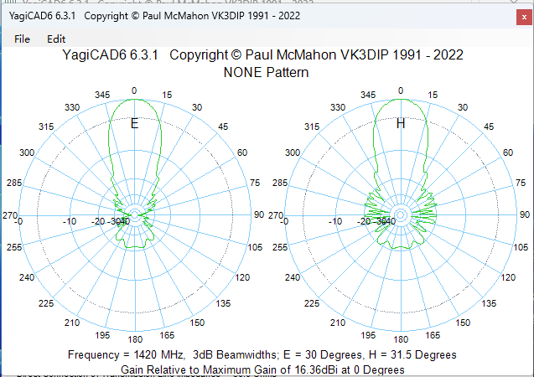
优化方法1——优化前后对比
优化前
优化后

Slide 15
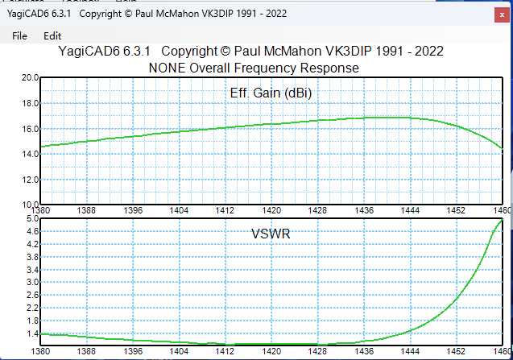
优化方法1——优化前后对比
优化前
优化后

Slide 16
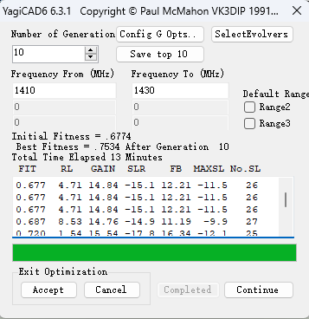
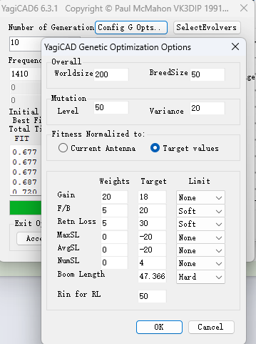
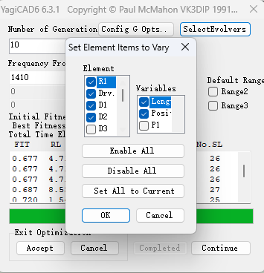
优化方法2——分步优化
0.677 4.71 14.84 -15.1 12.21 -11.5 26
0.677 4.71 14.84 -15.1 12.21 -11.5 26
0.677 4.71 14.84 -15.1 12.21 -11.5 26
0.687 8.53 14.76 -14.9 11.19 -9.9 27
0.720 1.54 15.54 -17.8 16.34 -12.1 25
0.738 9.36 15.22 -17.1 14.75 -11.4 27
0.739 5.21 15.89 -19.4 14.61 -10.5 26
0.750 4.51 16.00 -19.7 15.88 -10.7 26
0.750 4.51 16.00 -19.7 15.88 -10.7 26
0.751 9.19 15.66 -18.0 14.44 -12.6 26
0.753 8.79 15.61 -18.2 15.17 -12.3 26

Slide 17
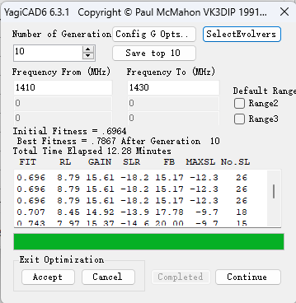
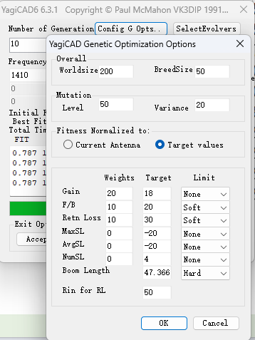
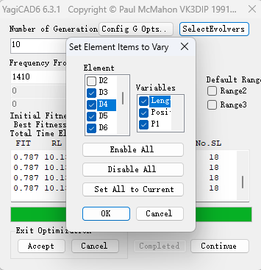
优化方法2——分步优化
0.696 8.79 15.61 -18.2 15.17 -12.3 26
0.696 8.79 15.61 -18.2 15.17 -12.3 26
0.696 8.79 15.61 -18.2 15.17 -12.3 26
0.707 8.45 14.92 -13.9 17.78 -9.7 18
0.743 7.97 15.37 -14.6 20.00 -9.7 15
0.743 7.97 15.37 -14.6 20.00 -9.7 15
0.753 8.69 16.37 -17.2 18.04 -11.9 17
0.787 10.13 16.28 -16.4 20.00 -12.9 18
0.787 10.13 16.28 -16.4 20.00 -12.9 18
0.787 10.13 16.28 -16.4 20.00 -12.9 18
0.787 10.13 16.28 -16.4 20.00 -12.9 18

